Slide 1
Chapter-2
Software Project Planning and Integration Management

Slide 2
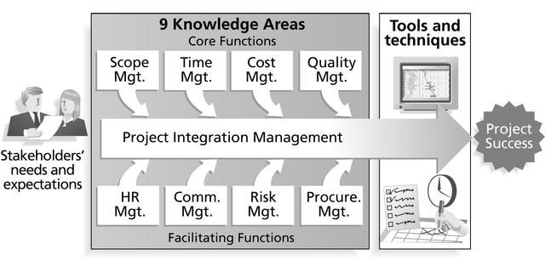

Slide 3
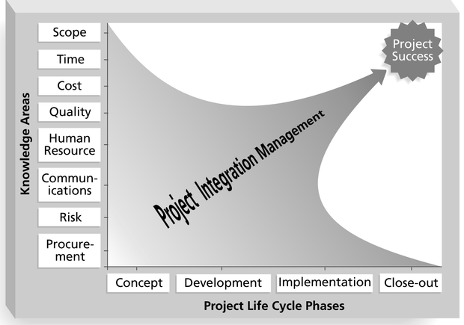
Framework for Project Integration Management
Focus on pulling everything together to reach project success!

Slide 4
Projects Cannot Be Run In Isolation
Projects must operate in a broad organizational environment
Project managers need to take a holistic or systems view of a project and understand how it is situated within the larger organization

Slide 5
A Systems View of Project Management
A systems approach emerged in the 1950s to describe a more analytical approach to management and problem solving
Three parts include:
  Systems philosophy: View things as systems, interacting components working within an environment to fulfill some purpose
  Systems analysis: problem-solving approach
  Systems management: Address business, technological, and organizational issues before making changes to systems

Slide 6
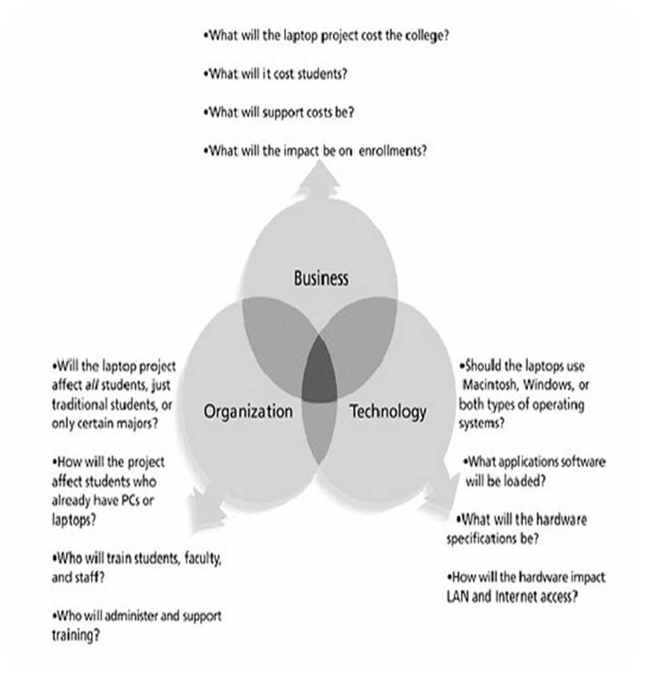
Three Sphere Model for Systems Management

Slide 7
Project Integration Management Processes
Project Plan Development: taking the results of other planning processes and putting them into a consistent, coherent document—the project plan
Project Plan Execution: carrying out the project plan
Integrated Change Control: coordinating changes across the entire project

Slide 8
The Key to Overall Project Success: Good Project Integration Management
Project managers must coordinate all of the other knowledge areas throughout a project’s life cycle
Many new project managers have trouble looking at the “big picture” and want to focus on too many details
Project integration management is not the same thing as software integration

Slide 9
Project Plan Development
A project plan is a document used to coordinate all project planning documents
Its main purpose is to guide project execution
Project plans assist the project manager in leading the project team and assessing project status
Project performance should be measured against a baseline project plan

Slide 10
Attributes of Project Plans
Just as projects are unique, so are project plans
Plans should be dynamic
Plans should be flexible
Plans should be updated as changes occur
Plans should first and foremost guide project execution

Slide 11
Common Elements of a Project Plan
Introduction or overview of the project
Description of how the project is organized
Management and technical processes used on the project
Work to be done, schedule, and budget information

Slide 12
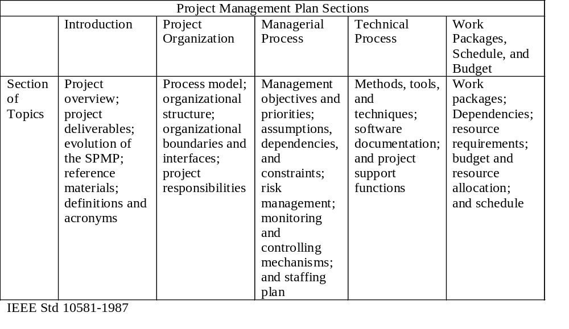
Sample Outline for a Software Project Management Plan (SPMP)

Slide 13
Stakeholder Analysis
A stakeholder analysis documents important (often sensitive) information about stakeholders such as
  stakeholders’ names and organizations
  roles on the project
  unique facts about stakeholders
  level of influence and interest in the project
  suggestions for managing relationships

Slide 14
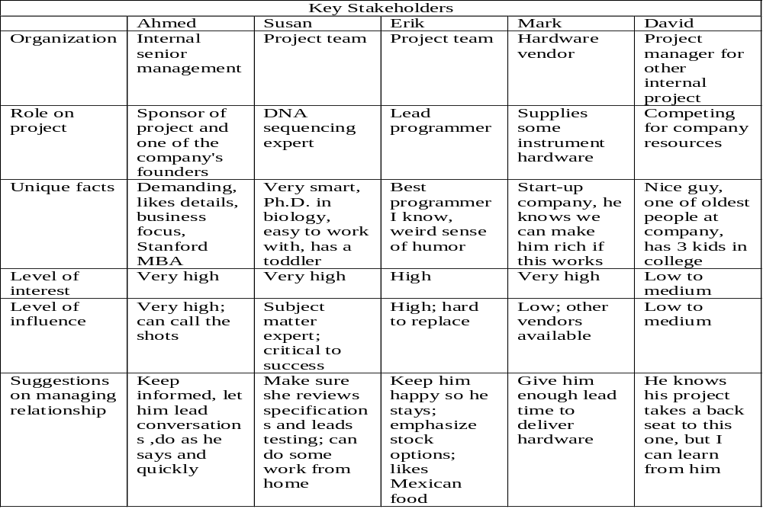
Sample Stakeholder Analysis

Slide 15
Project Plan Execution
Project plan execution involves managing and performing the work described in the project plan
The majority of time and money is usually spent on execution
The application area or the project directly affects project execution because the products of the project are produced during execution

Slide 16
Important Skills for Project Execution
General management skills like leadership, communication, and political skills
Product skills and knowledge
Use of specialized tools and techniques

Slide 17
Tools and Techniques for Project Execution
Work Authorization System: a method for ensuring that qualified people do work at the right time and in the proper sequence
Status Review Meetings: regularly scheduled meetings used to exchange project information
Project Management Software: special software to assist in managing projects

Slide 18
Integrated Change Control
Integrated change control involves identifying, evaluating, and managing changes throughout the project life cycle (Note: 1996 PMBOK called this process “overall change control”)
Three main objectives of change control:
  Determine that a change has occurred
  Influence the factors that create changes to ensure they are beneficial
  Manage actual changes when and as they occur

Slide 19
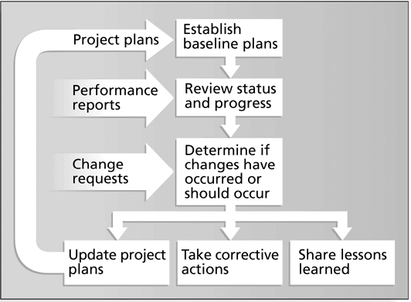
Integrated Change Control Process

Slide 20
Change Control on Software Projects
Former view: The project team should strive to do exactly what was planned on time and within budget
Problem: Stakeholders rarely agreed up-front on the project scope, and time and cost estimates were inaccurate
Modern view: Project management is a process of constant communication and negotiation
Solution: Changes are often beneficial, and the project team should plan for them

Slide 21
Change Control System
A formal, documented process that describes when and how official project documents and work may be changed
Describes who is authorized to make changes and how to make them
Often includes a Change Control Board (CCB), configuration management, and a process for communicating changes

Slide 22
Change Control Boards (CCBs)
A formal group of people responsible for approving or rejecting changes on a project
Provides guidelines for preparing change requests, evaluates them, and manages the implementation of approved changes
Includes stakeholders from the entire organization

Slide 23
Making Timely Changes
Some CCBs only meet occasionally, so it may take too long for changes to occur
Some organizations have policies in place for time-sensitive changes
  “48 hour policy” allowed project team members to make decisions, then they had 48 hours reverse the decision pending senior management approval
  Delegate changes to the lowest level possible, but keep everyone informed of changes

Slide 24
Configuration Management
Ensures that the products and their descriptions are correct and complete
Concentrates on the management of technology by identifying and controlling the functional and physical design characteristics of products
Configuration management specialists identify and document configuration requirements, control changes, record and report changes, and audit the products to verify conformance to requirements

Slide 25
Suggestions for Managing Integrated Change Control
View project management as a process of constant communications and negotiations
Plan for change
Establish a formal change control system, including a Change Control Board (CCB)
Use good configuration management
Define procedures for making timely decisions on smaller changes
Use written and oral performance reports to help identify and manage change
Use project management and other software to help manage and communicate changes

Slide 26
End of part-1
Thank you

